Slide 1
Moving to the Top 50
Campus Faculty Meeting
December 12, 2013

Slide 2
We are not chasing the rankings…
Instead, we want to help the university, students and faculty– we are doing what we should be doing
Two main metrics

Slide 3
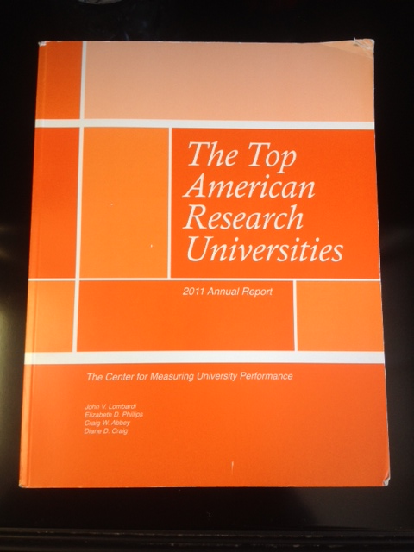

Slide 5
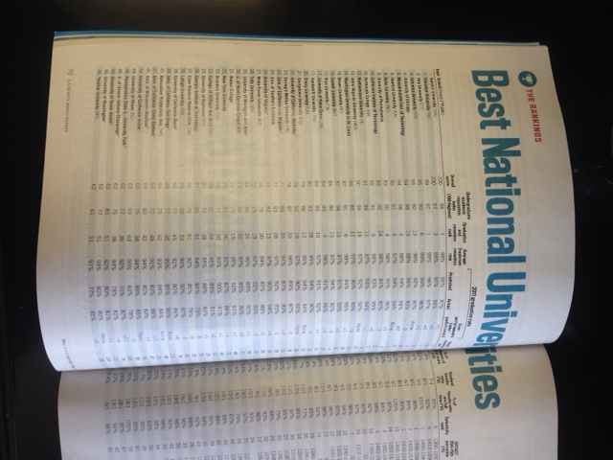

Slide 6
Enhancing U of A’s Reputation
Carnegie Foundation ranked as a Very High Research Activity University
USN&WR named U of A one of nine Up-and-coming Public Universities
U of A is the 13th fastest growing institution in the entire country
Student Business Plan teams have won twice as many national competitions as next school
Fay Jones School of Architecture ranked 19th in the nation, 8th among publics
25th Best Online Graduate Engineering Programs
Walton College 27th Best Public Business School
School of Law jumped to its highest ranking in history (36th, public)

Slide 9
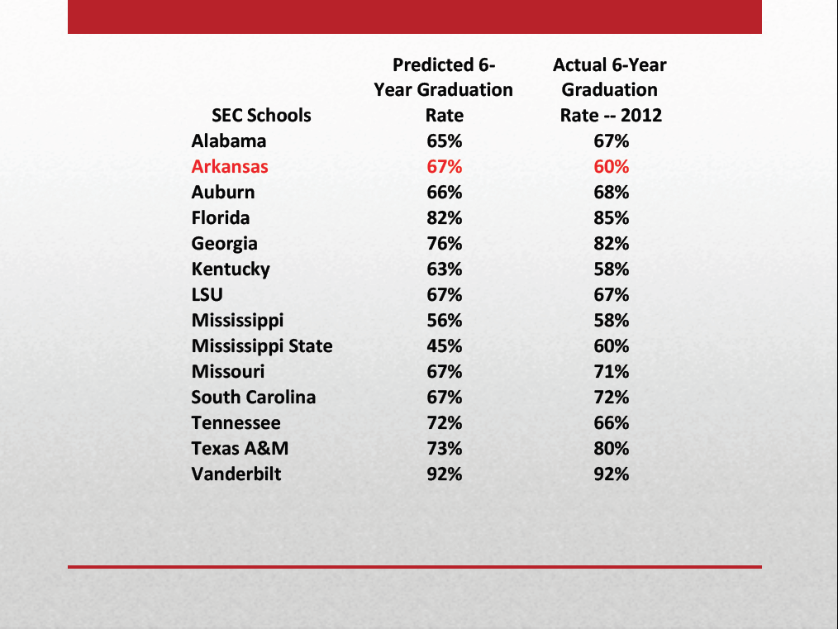

Slide 11
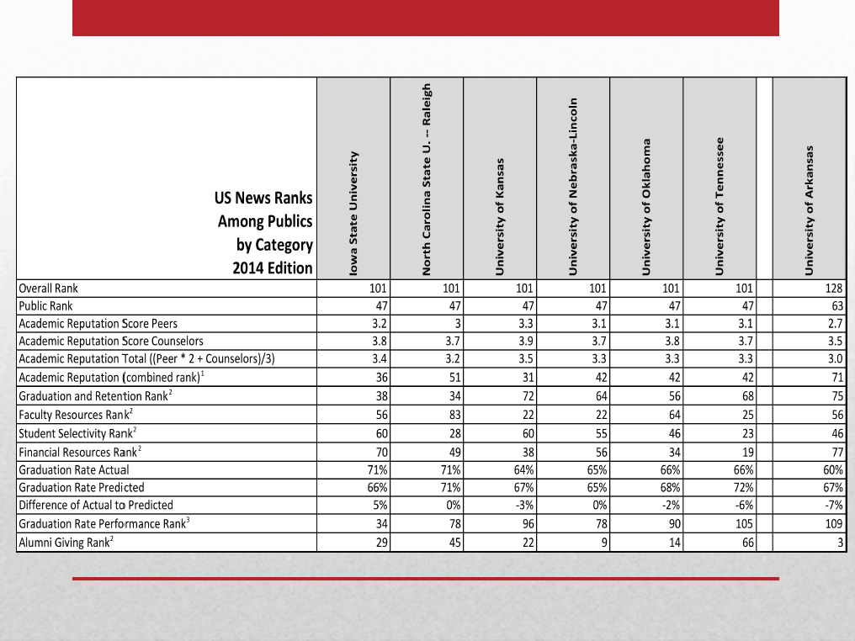

Slide 12
Top American Research Universities - 2012
 | University of Arkansas | Overall Ranking | Public Ranking
Total Research Expenditures (2010) | $104.3M | 136 | 97
Federal Research Expenditures (2010) | $32.7M | 176 | 128
Endowment Assets (2011) | $777.6M | 88 | 30
Annual Giving (2011) | $108.84M | 55 | 31
National Academy Members (2011) | 3 | 109 | 63
Faculty Awards in the Arts, Humanities, Science, Engineering, and Health (2011) | 8 | 78 | 49
Doctorates Granted (2011) | 166 | 102 | 72
Postdoctoral appointees (2010) | 103 | 123 | 83
SAT range (2010) | Not listed | Not listed (191 in 2009) | Not listed (45 in 2009)
If UA had more than $40M in fed exp., we would have tied for #38 public (with Colorado State, Hawaii, Houston, Nebraska, Oregon, South Carolina, and VCU).

Slide 13
RED Strategic Planning
Empowering the university community to excel at competitive research and promote economic growth
Faculty Engagement
Research Clusters
Research Infrastructure
Student Empowerment
An Economic Engine
Communication & Branding
Notes:
Initial workshop on November 25-26, 2013
Involvement
Faculty Senate leadership
Graduate and Undergraduate Students
Research Council
Associate Deans for Research
Center and Institute Directors
VPRED Leadership

Slide 14
Research Strengths Across Multiple Colleges and Schools
American Art, Architecture & Humanities
Supply Chain, Retail, & Transportation
Nano- technology
Energy & the Environment
Food Safety
Health
High Performance Computing
Entrepreneurship
International Relations/Global Outreach
Sustainability
Cross-cutting activities
Notes:
Colleges may have their own research strengths.
New interdisciplinary strengths may occur – For example, there are campus discussions on “Cybersecurity, Big Data, and Data Analytics”

Slide 15
Strategic Planning Actions (partial)
Research Faculty/
Post-docs
Cluster Hires
Research Foundation
Classified Research
Inter- disciplinary Research & Hires
Grant writing
Research Development
Grant Program Mgmt (+Financial)
Scientific and Administrative Support
Research Computing
Research Library (ARL)
Research Space
Entrepre-neurship
(start-ups)
Recognize IP generation
Retain Faculty
Senior Hires
Core Facilities
Undergrad research (The 3.0 student)
Encourage
Faculty Awards
Industry research
Get the Word Out!
(PR)
Collaboration with UAMS
Competitive start-up funding (w/ ROI )
Transformational Research Ideas
New faculty lines based on research needs
Media training for faculty
Federal Agency focus
New Investigator training
Seed funds
More Graduate students

Slide 16
http://provost.uark.edu/476.php
The University of Arkansas has stated its intention to become a Top 50 public research university by 2021. The Providing Transparency and Accountability to the People of Arkansas (TAP) document identifies 15 goals to enhance the university in reputation, quality of life, aesthetics and services.
The 5 goals identified here are drawn from the TAP document and provide the initial steps needed to begin the ascent to a Top 50 institution:
Increase undergraduate graduation rates and retention (TAP goal 5);
Improve graduation rates to 66% in 2015 and 70% in 2021
Enhance academic advising
Initiate a required freshman class on “Destination Graduation”
Increase research funding and scholarship (TAP goal 7);
Increase federal and extramural research expenditures
Increase journal and scholarly publications
Increase PhD and terminal degree production
Enhance library holdings

Slide 17
Increase top ranked graduate programs (TAP goals 1 and 12);
Increase number of graduate programs in the top 20 nationally
Increase PhD and terminal degree production
Enhance library holdings
Increase reputation (TAP 1 and 12);
Continue to inform opinion leaders about positive actions at the University of Arkansas
Increase PhD and terminal degree production
Increase the number of classes under 20 students (TAP goal 1 and 3).
Look to increase the number of classes with less than 20 students by adding additional sections.

