Slide 1
UA Faculty Presentation April 16, 2014
Shane Broadway, Director

Slide 2
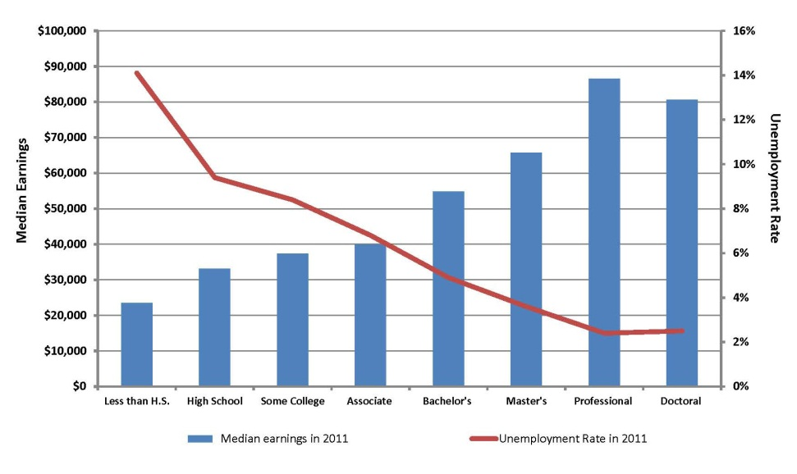
Value of Education

Slide 3
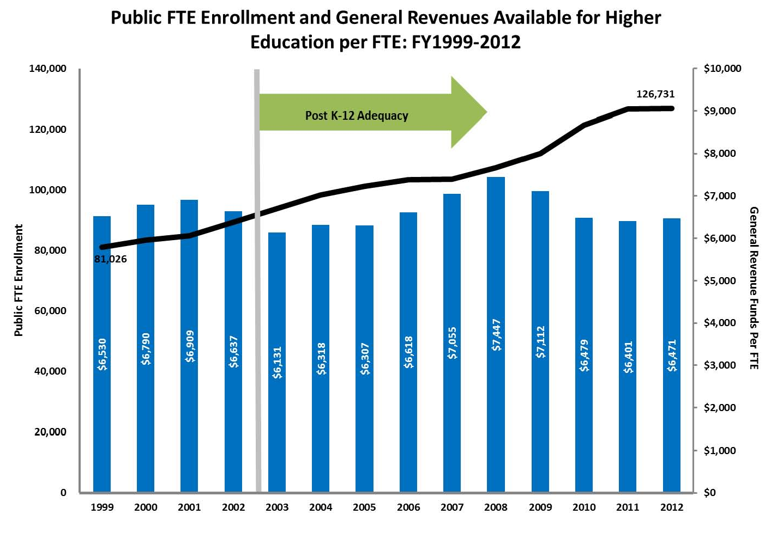
Public FTE Enrollment,General Revenue for Higher Ed per FTE

Slide 4
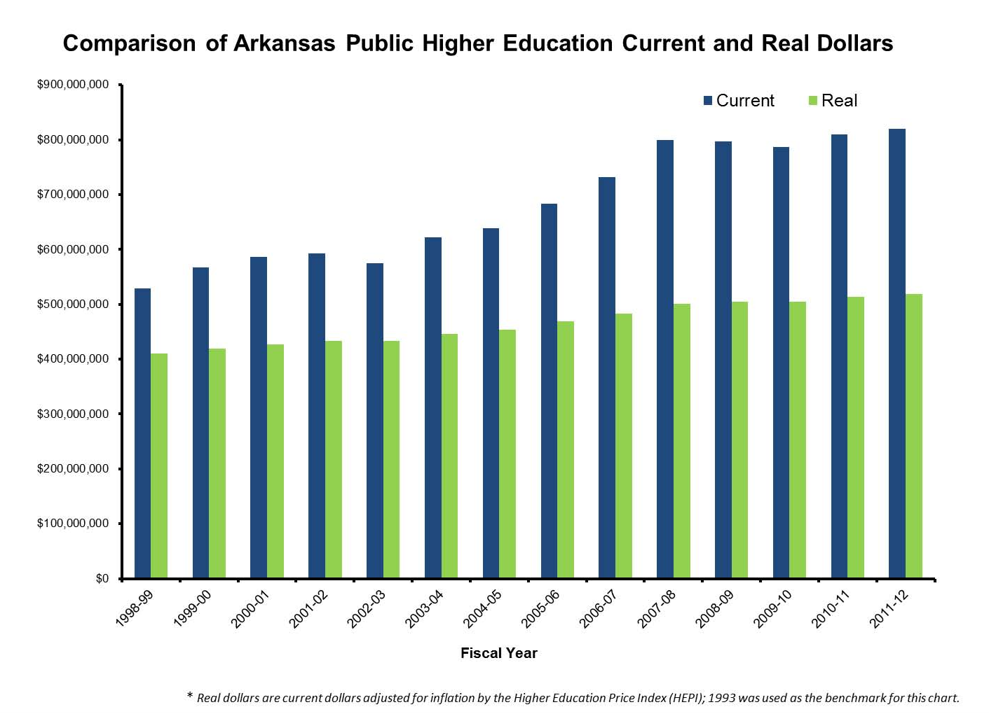
Higher Ed Current Vs. Real Dollars

Slide 5
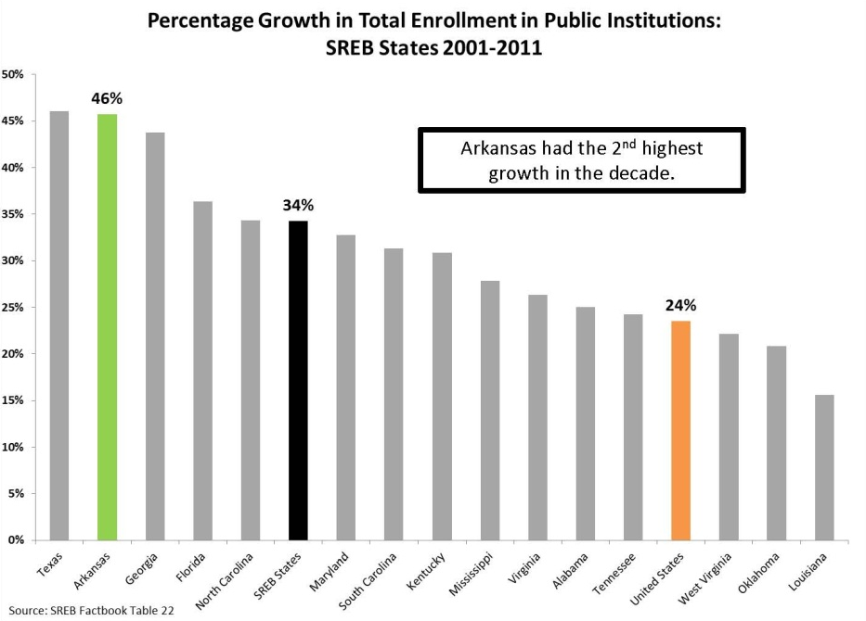
SREB Growth in Enrollment

Slide 6
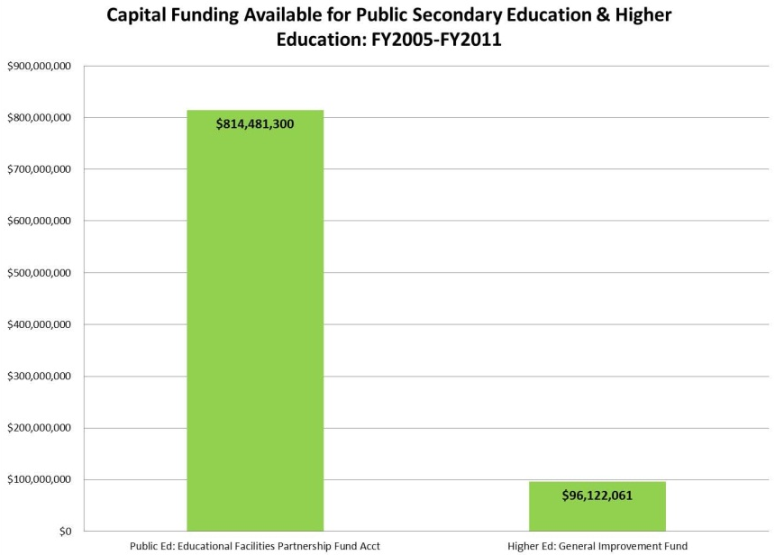
Capital Project Funding Available

Slide 7
Enrollment
Annual Unduplicated Headcount
Institution Type | AY2010 | AY2011 | AY2012 | AY2013
4-Year Universities | 109,726 | 113,316 | 115,654 | 115,801
2-Year Colleges | 88,415 | 88,301 | 89,130 | 84,981
Private/ Independents | 17,509 | 18,497 | 19,254 | 18,425
Nursing Schools | - | 1,159 | 1,114 | 1,134
ICAC Institutions | 12,952 | 14,801 | 13,758 | 14,943
Total | 228,602 | 236,074 | 238,910 | 235,284

Slide 8
Annual Unduplicated Headcount

Slide 9
AY13 Annual Unduplicated Headcount

Slide 10
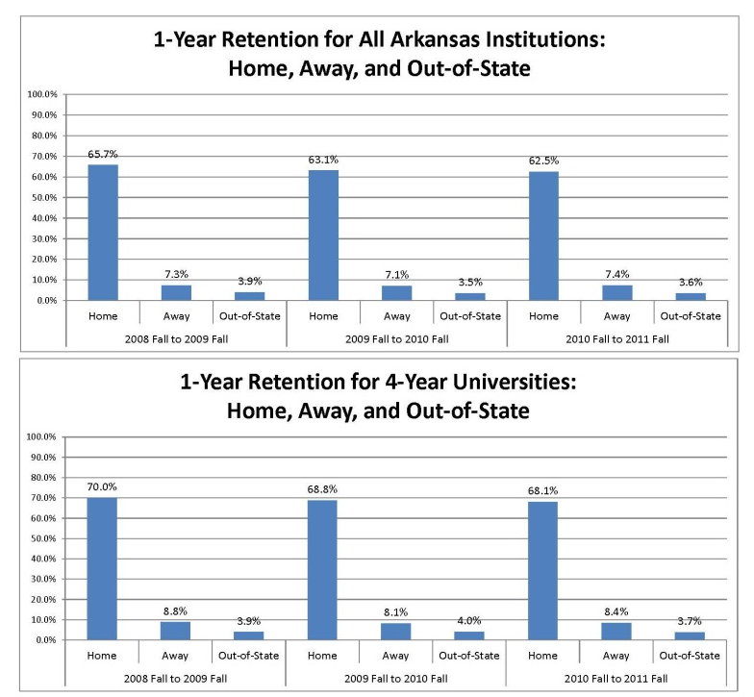
Retention Rates

Slide 11
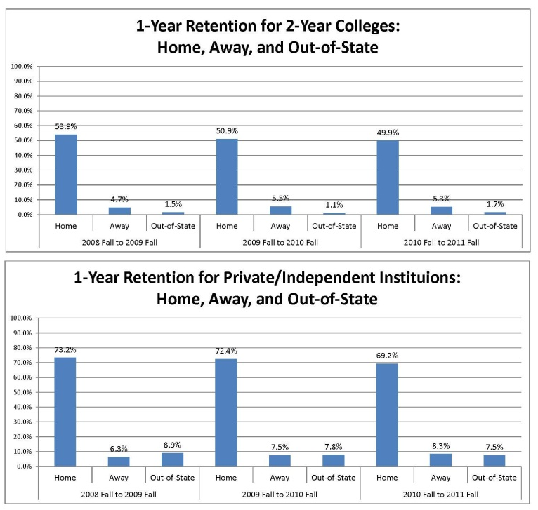
Retention Rates

Slide 12
Remediation is Down 1.6%
Remediation is down 1.6% (state total), down 1.4% (2-Year Colleges), and down 1.6% (4-Year Universities).

Slide 13
Math Remediation is Down 0.9%

Slide 14
English Remediation is Down 0.9%

Slide 15
Reading Remediation is Down 0.6%

Slide 16
Comparing Anytime, 2-Year, and 1-Year Remediation Rates

Slide 17
Students with High School GPA >= 3.00

Slide 18
Remediation Costs
2011 Figures
2011 Total Remediation Revenue $26,579,919
2011 Total Remediation Expenditures $49,755,078
2011 General Revenue Subsidy $23,175,159
2011 General Rev % of Total Expenditures 46.58%
(Report is also broken down by student type Freshman, Adult & Other)
2012 Figures
2012 Total Remediation Revenue $25,573,855
2012 Total Remediation Expenditures $46,832,124
2012 General Revenue Subsidy $21,258,269
2012 General Rev % of Total Expenditures 45.39%
(Report is also broken down by student type Freshman, Adult & Other)

Slide 19
Conclusion
Expenditures on remediation have decreased by 3.79% from 2011 to 2012
General Revenue subsidy has decreased by 8.27% from 2011 to 2012
General Revenue as a % of Total Expenditures has decreased by 1.2% from 2011 to 2012

Slide 20
Graduation Rates of Remediated Students
Remediated students graduate at substantially lower rates at both 4-Year Universities and 2-Year Colleges.

Slide 21
Graduation Rates
6-Year Rates (150%)
Graduation Rates are steadily improving at both 4-Year Universities and 2-Year Colleges. However, the rate for 2-Year Colleges dropped 1.2 percentage points for the most recent cohort, whereas it improved by 1.3 percentage points for 4-Year Universities.
3-Year Rates (150%)

Slide 22
Initiatives/Projects
‘Credit When It’s Due’ reverse transfer grant
  $500,000 from Lumina, Kresge, Gates Foundation
K-12 ACHIEVE College and Career Readiness Policy Initiative (NGA)
Partnership for Assessment of Readiness for College and Careers (PARCC)
Accelerating Opportunity Project – four colleges are redesigning one-semester certificate level career and technical education programs so GED students can enroll and complete a GED credential while completing the career and technical education certificate.

Slide 23
Academic Challenge Scholarships
Fiscal Year | 2011 | 2012 | 2013
Academic Challenge Traditional | 11,317 | 11,960 | 12,865
Academic Challenge Traditional Continuing Eligibility | -- | 6,728 | 12,579
Academic Challenge Traditional Original | 4,963 | 3,125 | 1,456
Academic Challenge Current Achiever | 6,162 | 4,771 | 2,592
Academic Challenge Nontraditional | 8,689 | 4,525 | 3,578
Total | 31,131 | 31,109 | 33,070

Slide 24
Important to Know
Deadline for all categories – both spring and fall semester – is June 1
Amounts for those who received the ACS in 2010 and continued his or her eligibility will receive same amounts – $5,000 or $2,500
Amounts for those who received the ACS in 2011 and 2012 and continued his or her eligibility will receive same amounts – $4,500 or $2,250
New awards are $2K, $3K, $4K and $5K as a freshman, sophomore, junior or senior respectively, with $2K only at two-year college

Slide 25
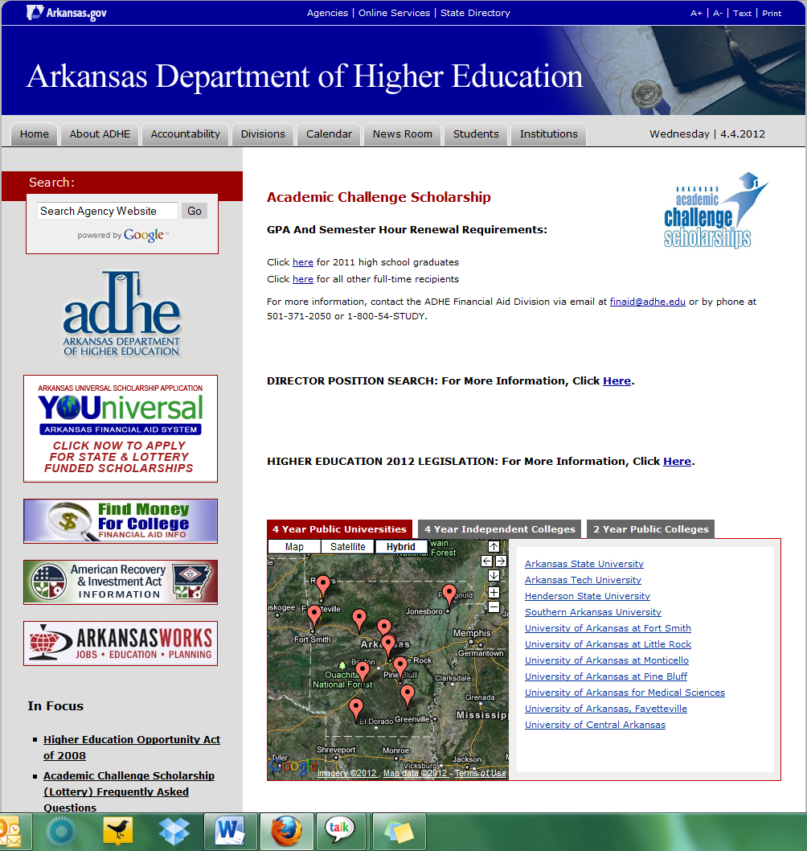
www.ADHE.edu

Slide 26

Free Smart Phone App

Slide 27
PERFORMANCE-BASED FUNDING (OUTCOMES-CENTERED) RESULTS

Slide 28
Universities
Methodology
Total Possible Points = 10
Compensatory points for percentage of Pell receiving undergraduates may be added to the total points, but cannot increase the total points above 10.

Slide 29
Universities
Mandatory Measures – maximum of 4 points
  Bachelor Credentials
  Total Credentials
  STEM Credentials
  Progression
Optional Measures – maximum of 6 points
  Minority Credentials
  Non-Traditional Credentials
  Remedial Credentials
  Transfer Student Credentials
  Course Completion
  External Grants & Awards
  Regional Economic Needs Credentials

Slide 30
Universities - Measures

Slide 31
Universities - Results

Slide 32
Colleges
Methodology
Total Possible Points = 10
Compares average of the most recent 3 years to an average of the most recent 5 years
Compensatory points for special populations (based on percentage of enrollment) may be added to mandatory total

Slide 33
Colleges
Mandatory Measures – maximum of 6 points
  Course Completion
    Remedial
    Non-Remedial
  Progression
  Credentials
    Certificates of Proficiency
    Technical Certificates
    Associate Degrees
    Total Credentials (rate)
  Compensatory
    Low-Income
    Underprepared
Region/Mission Measures – maximum of 4 points
  STEM Credentials
  High Demand Credentials
  Adult Credentials
  Minority Credentials
  Transfer Students
  Workforce Training

Slide 34
Colleges - Measures

Slide 35
Colleges - Results

